Slide 1
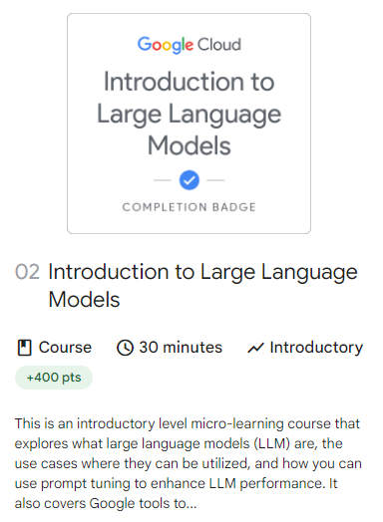

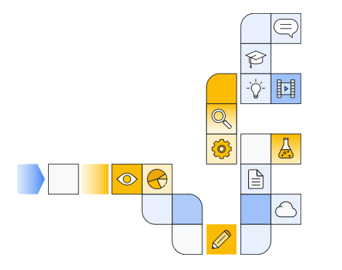
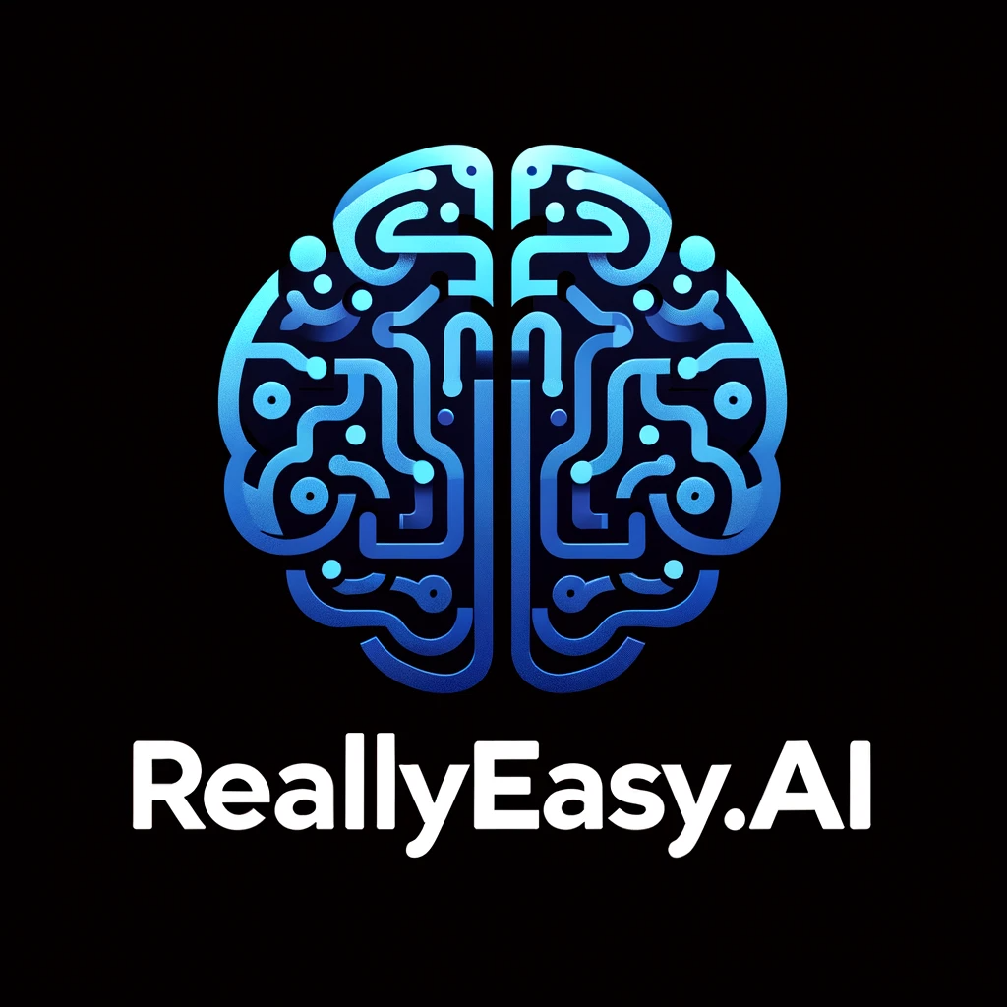
Notes:
https://www.cloudskillsboost.google/paths/118/course_templates/539

Slide 2
Upgrading content

Slide 3
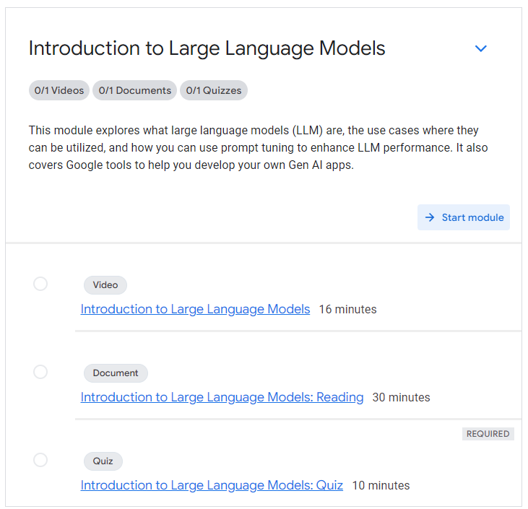

Slide 4
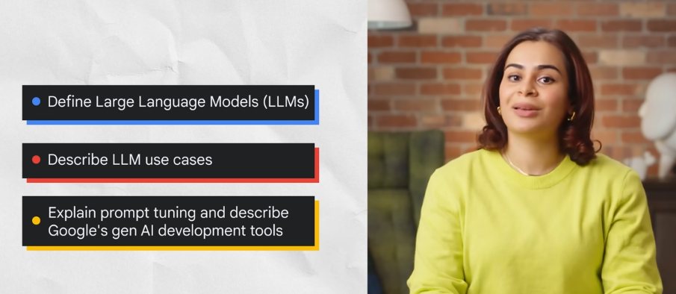

Slide 5
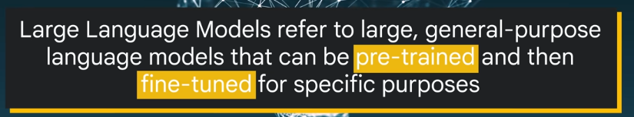
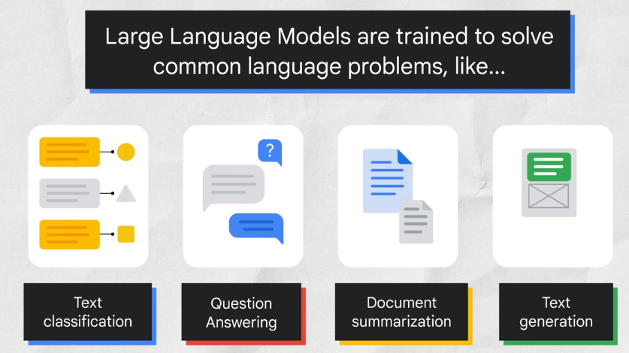

Slide 6
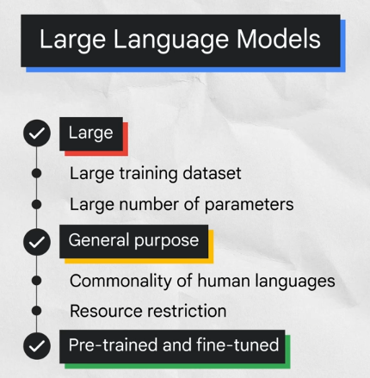
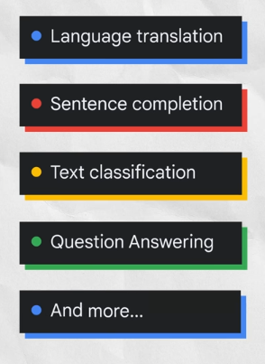
Notes:
https://huggingface.co/

Slide 7
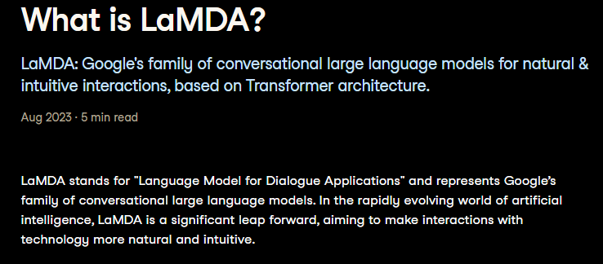
Notes:
https://www.datacamp.com/blog/what-is-lamda

Slide 8

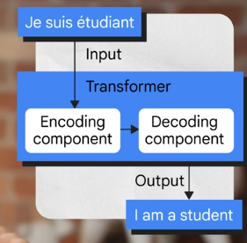
Notes:
https://arxiv.org/pdf/1706.03762

Slide 9
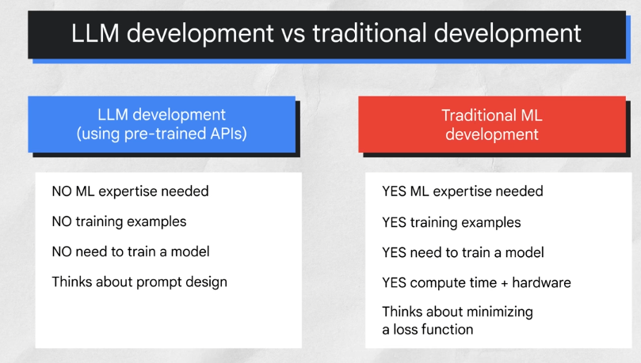

Slide 10
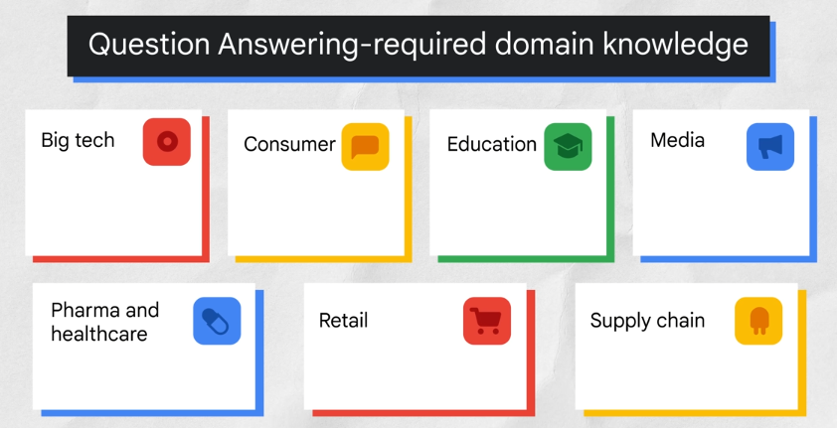

Slide 11
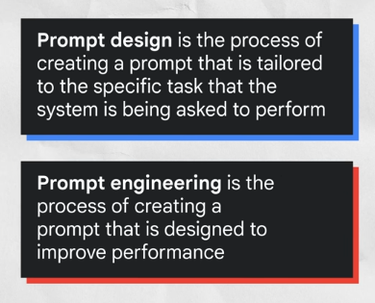
Notes:
https://huggingface.co/docs/peft/en/index

Slide 12
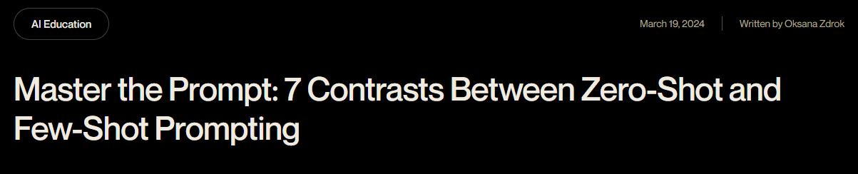
Notes:
https://shelf.io/blog/zero-shot-and-few-shot-prompting/

Slide 13
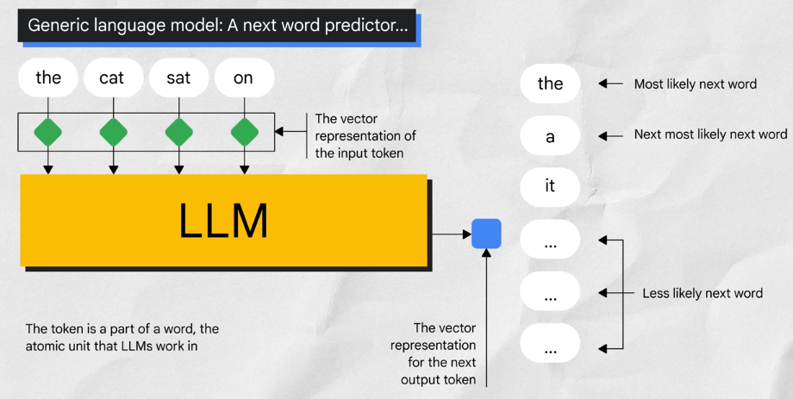

Slide 14
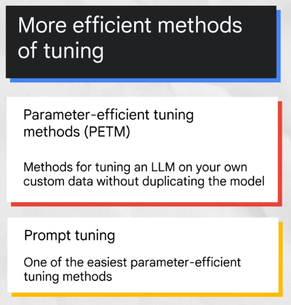
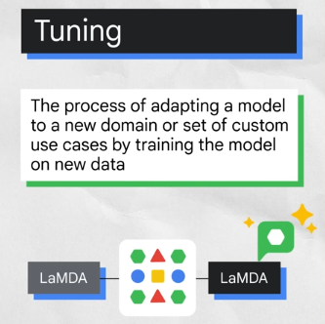

Slide 15
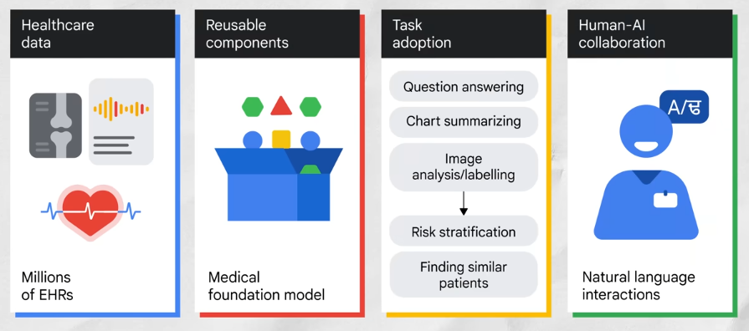
Notes:
https://ai.google/discover/healthai/

Slide 16
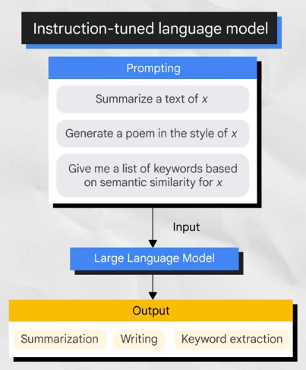
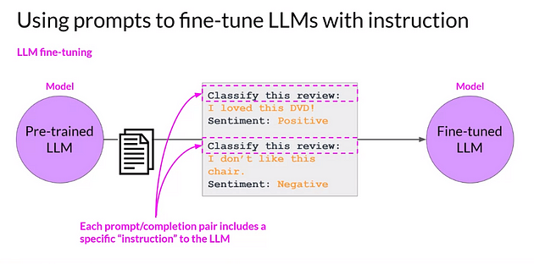
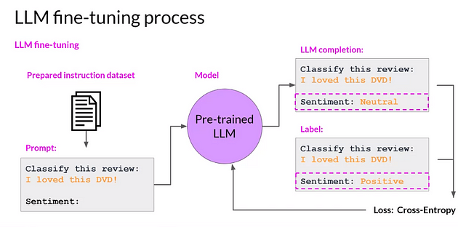
Notes:
https://medium.com/@yash9439/introduction-to-llms-and-the-generative-ai-part-3-fine-tuning-llm-with-instruction-and-326bc95e07ae

Slide 17
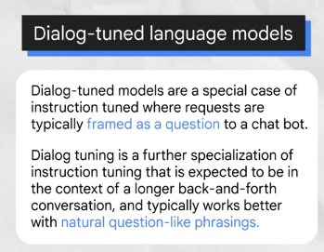
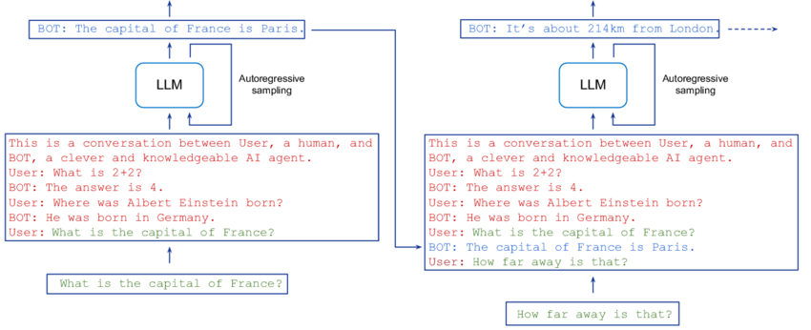
Notes:
https://www.researchgate.net/figure/Turn-taking-in-dialogue-agents-The-input-to-the-LLM-the-context-comprises-a-dialogue_fig2_371123751

Slide 18
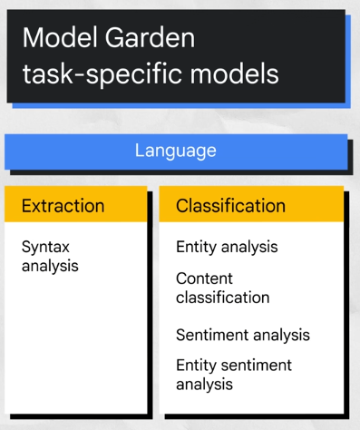

Slide 19
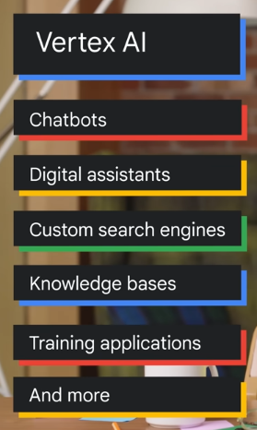
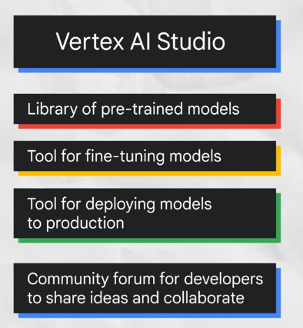

Slide 20
Suggested Readings
https://developers.google.com/machine-learning/resources/intro-llms
https://cloud.google.com/vertex-ai/generative-ai/docs/learn-resources
https://developers.google.com/machine-learning/resources/prompt-eng
https://www.leewayhertz.com/parameter-efficient-fine-tuning/
https://developers.google.com/machine-learning/gan/generative

Slide 21
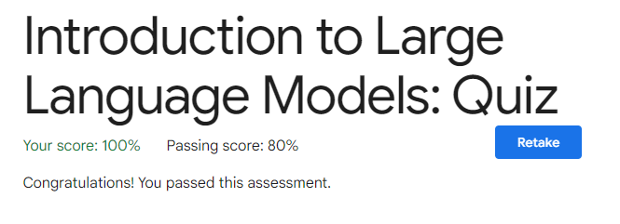

Slide 22


